Slide 1
Forecast on Civilian Unemployment Rate
Group 3 team Members:
Ajinkyaraje Ghorpade
Darshit Gandhi
Mengqi Luo
Sandeep Ramesh
Sathya Narayanan
Sneha Naik
Zhe Sun

Slide 2
Brief Data Overview
Unemployment rate represents the number of unemployed as a percentage of the labor force.
Time series of unemployment rate (u-3)
01/01/1948 –03/01/2017
Monthly recorded
Without seasonal adjustment
Source : US Bureau of Labor Statistics, Civilian Unemployment Rate[UNRATENSA], FRED

Slide 3
Why are we forecasting ?
An important economic indicator
Affects the banks’ decisions to grant student loans
Cause and effect relationship with the housing market
Crucial decision making tool for business & government
Common labor force planning metric

Slide 4
Outline
Data and Holdout
Unit Root Test
ACF and PACF on Data
Forecast Models
Model Validation
Forecast & Conclusions

Slide 5
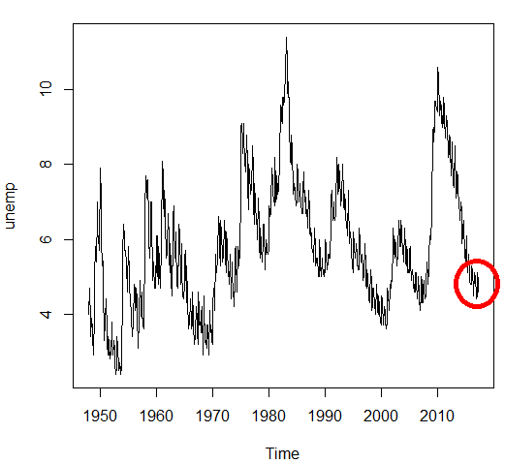
Initial Plot

Slide 6
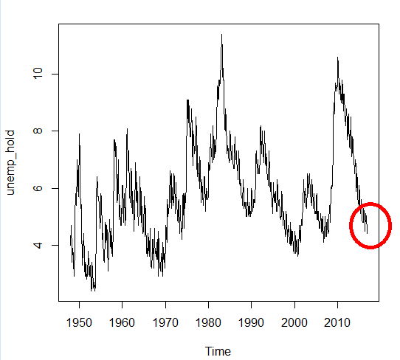
Plot of the restricted sample

Slide 7
Unit Root Test Rationale
In observance of stochastic variations
Seasonality in every 12th month
Differencing the data might be needed. This could be confirmed by performing a unit root test.

Slide 8
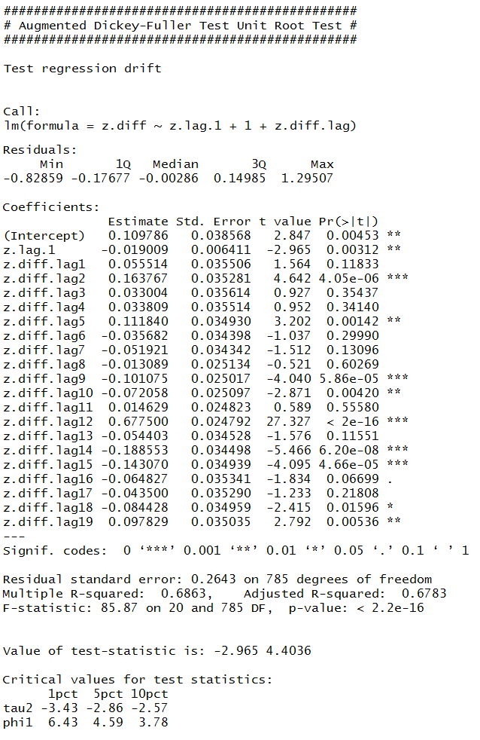

Unit Root Test

Slide 9
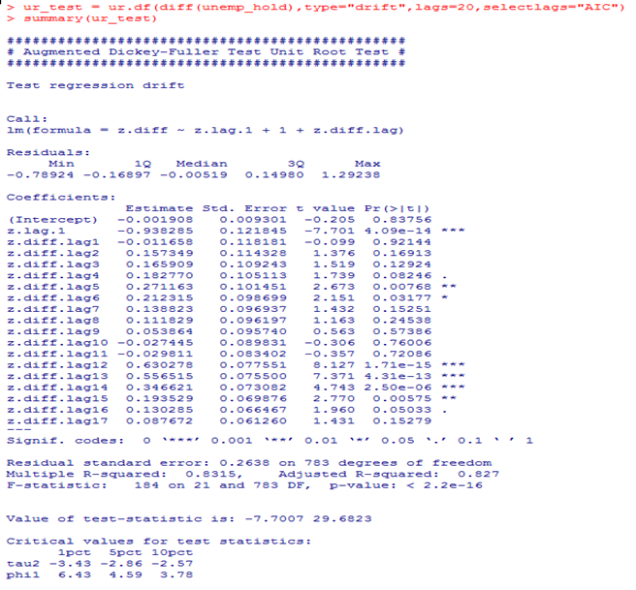
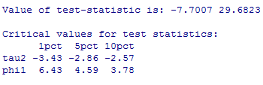
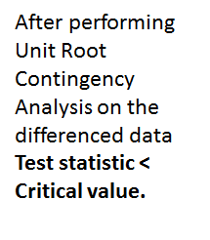
Unit Root Test After Differencing

Slide 10
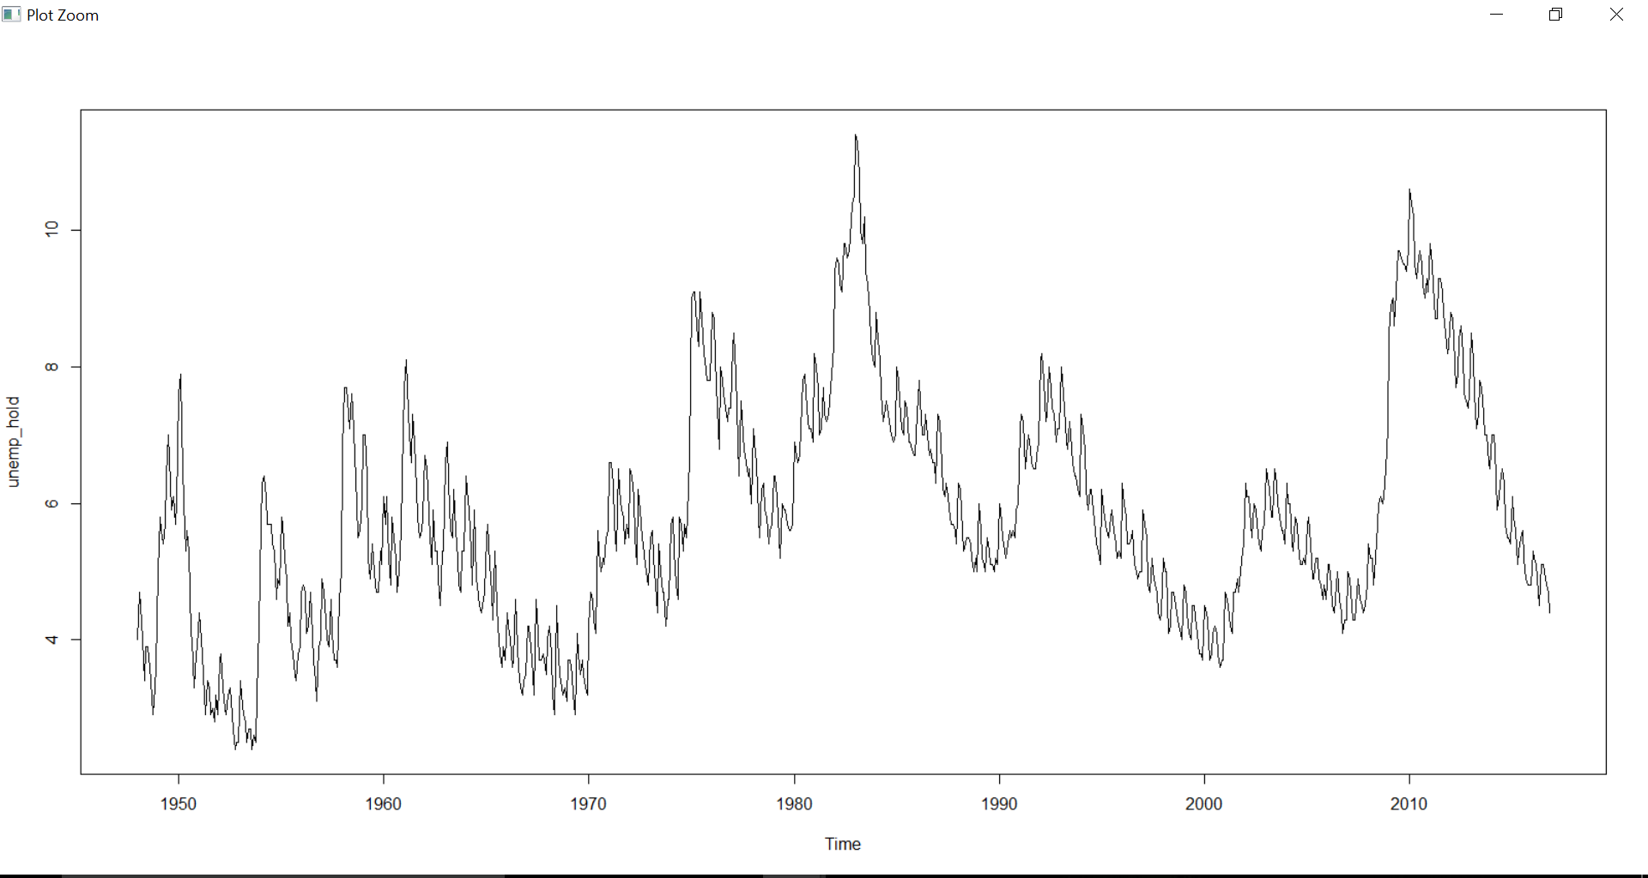
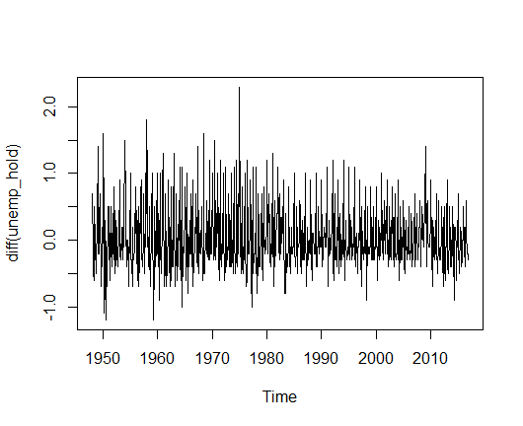
Plot of the Differenced Data

Slide 11
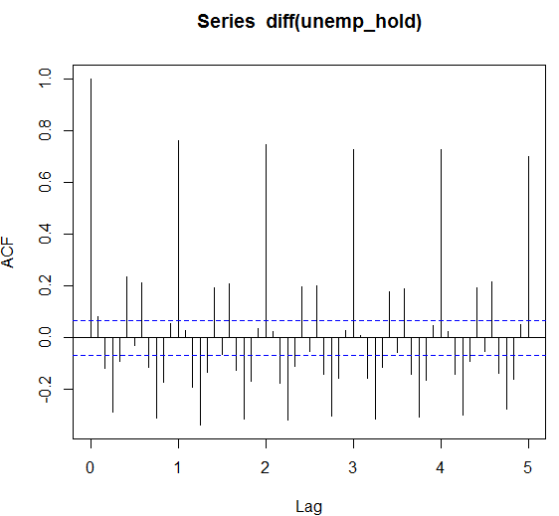
ACF of the Series for 60 lags

Slide 12
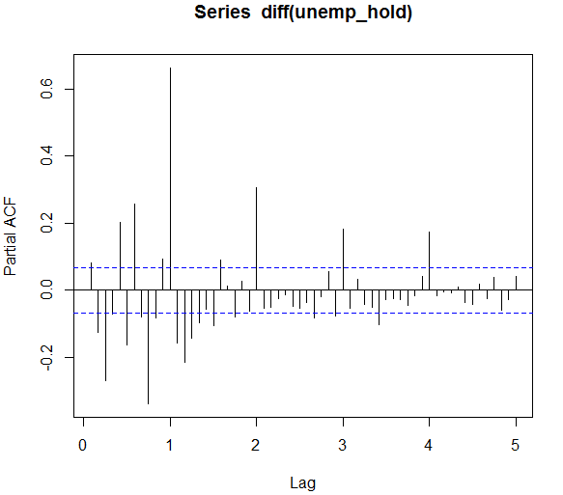
PACF of the Series 60 lags

Slide 13
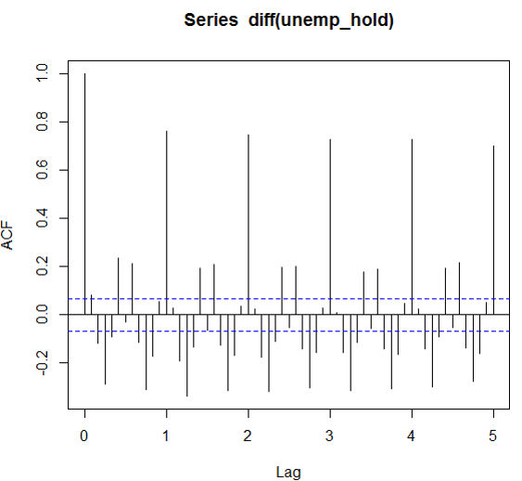

Interpretation of Correlograms
ACF
PACF

Slide 14
Model Comparisons
Model | AIC | BIC
SARIMA(1,1,1)(1,0,1) | -3.34 | 20.17
SARIMA(1,1,1)(2,0,1) | -1.86 | 26.44
SARIMA(2,1,1)(1,0,1) | -8.05 | 20.25
SARIMA(2,1,2)(1,0,1) | -6.23 | 26.79

Slide 15
Residual Diagnostic Check
Purpose :
Evaluation of selected model and its assumptions.
Influence of the residuals on the analysis
Residuals are crucial in model selection to infer :
Non-linearity
Non-constant variance
Independence
Outliers
Normal Distribution

Slide 16
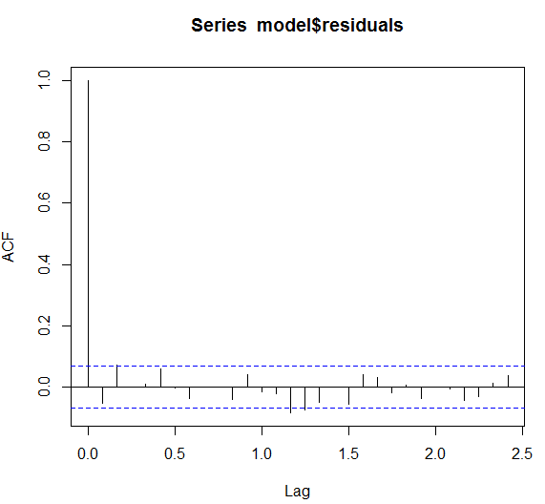
Residual Diagnostic Check
Residuals all below 95% confidence interval
There are no useful information in the residuals that we could have used in the model.

Slide 17
Residual Diagnostic Check
From our plot, we saw that our selected model has basically captured the patterns in our data quite effectively.
There is no significant spike in our ACF plot.
In conclusion, we can say that there is no more information remaining in our residuals to be further exploited in order to get better model to in turn get better forecasts.

Slide 18
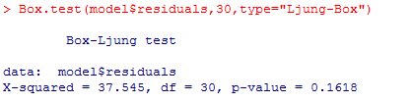
Model Validation
Chi-squared critical value is 50.892
Chi-squared critical value > Chi-squared test statistic value
So for 1% test size and 30 degrees of freedom, we fail to reject H0 that first 30 autocorrelation coefficients of the residuals are jointly equal to zero.
We can say that we don’t have enough evidence to prove Ha
H0 = first 30 autocorrelation coefficients of the residuals are jointly equal to zero.
Ha = H0
The associated p-value is 0.1618 which tells that 16.18% of all χ² (30) random variables exceed the value 37.545

Slide 19
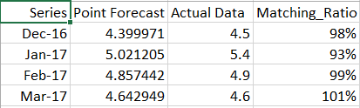
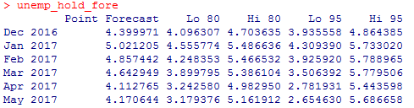
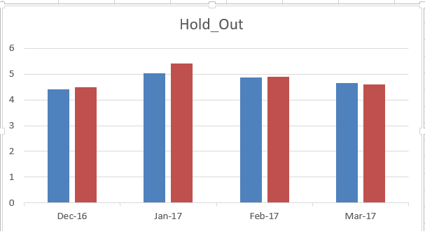
Forecast & Conclusions
Holdout period
SARIMA(1,1,1)(1,0,1)
Forecasted Value
Actual data point

Slide 20
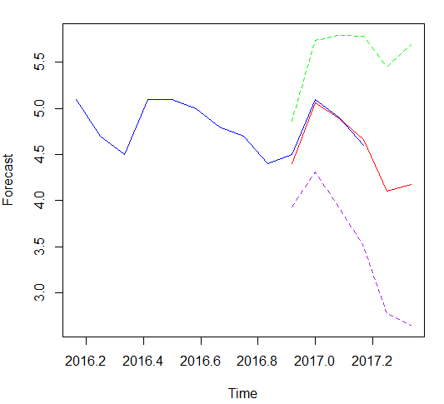
Forecast & Conclusions
Inflation control
Housing market
Federal Reserve
Stability

